Slide 1


FACULTY OF SCIENCES OF AGADIR Excellence Master's Program Data Analytics and Artificial Intelligence (ADIA)
Module: CyberSecurity
Project - N°2
Password Strength Analysis & Weakness Detection Model
Réalisé par:
KINAD Kawtar KHAIR Latifa
JIRARI Inass IZIKKI Hajar
Encadre Par :
Pr. BOUGHROUS Moncef

Slide 2

1
2
3
4
5
6
7
The Cybersecurity Problem: Why Passwords Fail
Project Goals : From "Length" to "Strength"
  Data Pipeline and Feature Engineering
  Initial Finding: Low Complexity & Entropy
SOMMAIRE
  Model Selection Justification
  Feature Importance: The Predictors
  Demonstration
8
  Actionable Recommendations for a SOC
  Conclusion
9

Slide 3
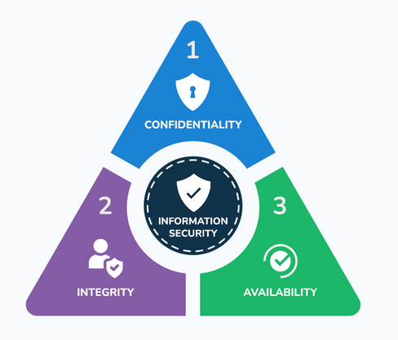


  The Cybersecurity Problem: Why Passwords Fail
1
2
3
The Critical Impact
CIA Triad
The Vulnerability
The Attacker's Methods
  Dictionary Attacks and Credential Stuffing:
These attacks leverage large lists of previously compromised or common passwords
The Weak Password is the primary entry point for attackers.
  Confidentiality: Private data is accessed.
  Brute Force Attacks:
involves systematically testing every conceivable character combination until the correct credential is identified.
  Integrity: Data is altered or deleted
  Availability : System is locked or down.
3

Slide 4
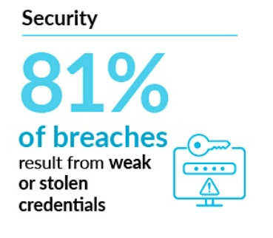
2. Project Goal: From "Length" to "Strength"
2.1. The Traditional Policy is Insufficient:
2.2. Core Objectives:
1
Quantify Vulnerability:
The old "length-only" policy is a critical failure. A credential like 12345678 meets the length requirement but offers zero security against common attacks.
Our project's goal is to quantify unpredictability (Shannon Entropy) and build an intelligent classifier to measure true strength.
Analyze the 14M+ passwords in the RockYou.txt dataset to find real, statistical weakness patterns
2
Develop an Accurate ML Model
Build and train a Random Forest Classifier to accurately predict the strength of any new password.
3
Provide Actionable Recommendations
Use the model's results (Feature Importance) to provide data-backed security policies for a Security Operations Center (SOC).
4

Slide 5




3. Data Pipeline and Feature Engineering
How we turn 14M raw text passwords into predictable data ?
2. Feature Engineering
We created 8 key predictive features:
3. AI Model Input
1. Data Source
  length
  count_lower
  count_upper
  count_digit
  count_symbol
  Key Feature:
  char_classes
  shannon_entropy
  is_common_pattern
Random Forest
SVM
LogisticRegression
....
RockYou.txt Dataset
14.3 Million Raw Passwords
5

Slide 6
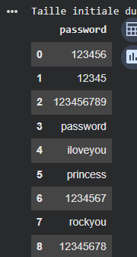
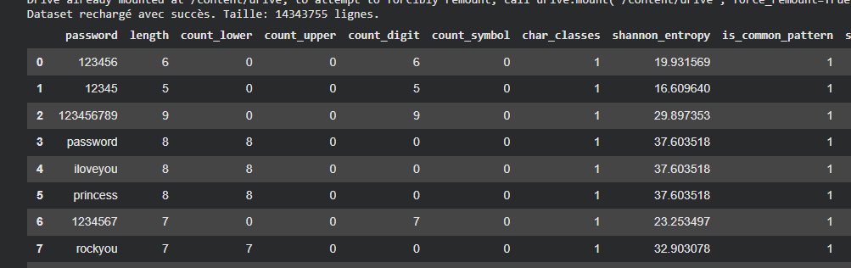
3. Data Pipeline and Feature Engineering
Feature Engineering: The Transformed Dataset
Meaning of Key Predictive Features
  char_classes (Complexity)
  A score from 1 to 4 (Types used: lowercase, uppercase, digits, symbols).
  It’s our strongest predictor. Score of 4 is essential for maximizing defense.
2. shannon_entropy (Theoretical Strength)
  Unpredictability score in bits. Measures resistance to Brute Force.
  Calculation: Length×log2(Alphabet Size).
  Goal: We set a security baseline of ≥60 bits.
3. is_common_pattern (Contextual Risk):
  It’s a binary flag for sequences, repetitions, or dictionary words (e.g., 12345, qwerty).
  It Protects against instant failure from Dictionary Attacks.
6

Slide 7
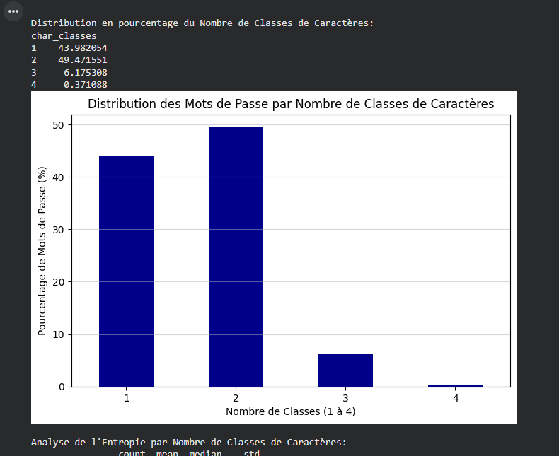
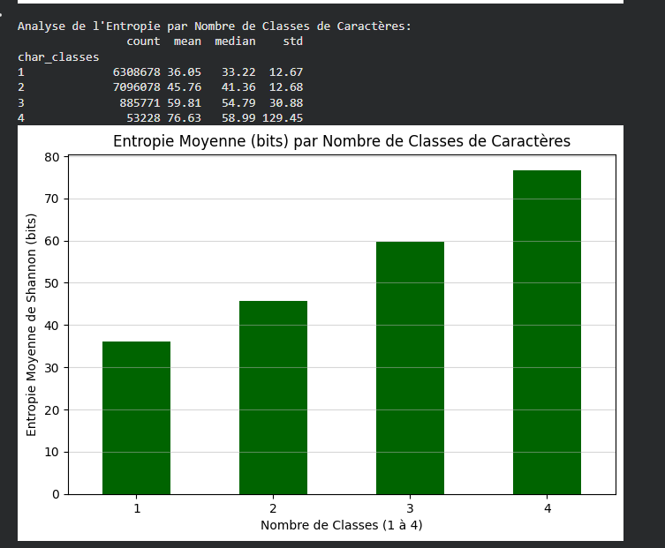
4. Initial Finding: Low Complexity & Entropy
FINDING 1: Low Complexity is Common
FINDING 2: Low Entropy is the Result
Users avoid complex characters.
This behavior leads to low entropy (strength).
  The average password (Class 1-3) is far below the 60-bit security standard.
  Adding the 4th class (symbols) is the *only* action that significantly increases strength (from 52 to 70 bits).
  45.4% of passwords use only 1 or 2 classes (e.g., all lowercase, or lowercase + numbers).
  Only 3.5% use all 4 classes (including symbols).
7

Slide 8
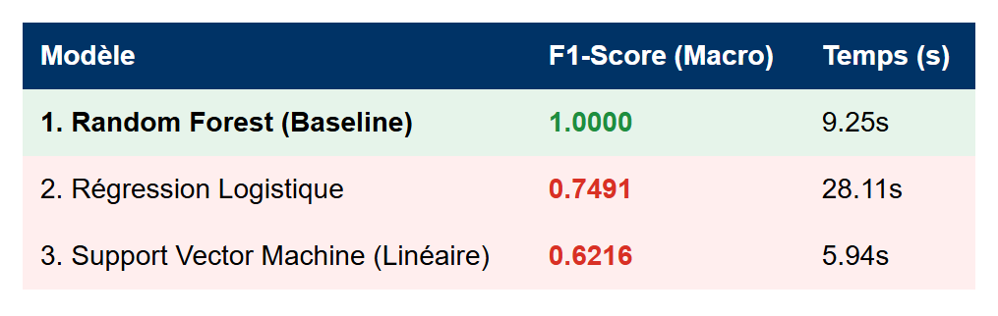
5. Model Selection Justification
i. Model Comparison (F1-Score):
  We tested multiple models. The Random Forest was the clear winner.
Key Insight: The problem is non-linear. A simple tree-based model (Random Forest) is required to accurately classify password strength based on our complex features.
8

Slide 9
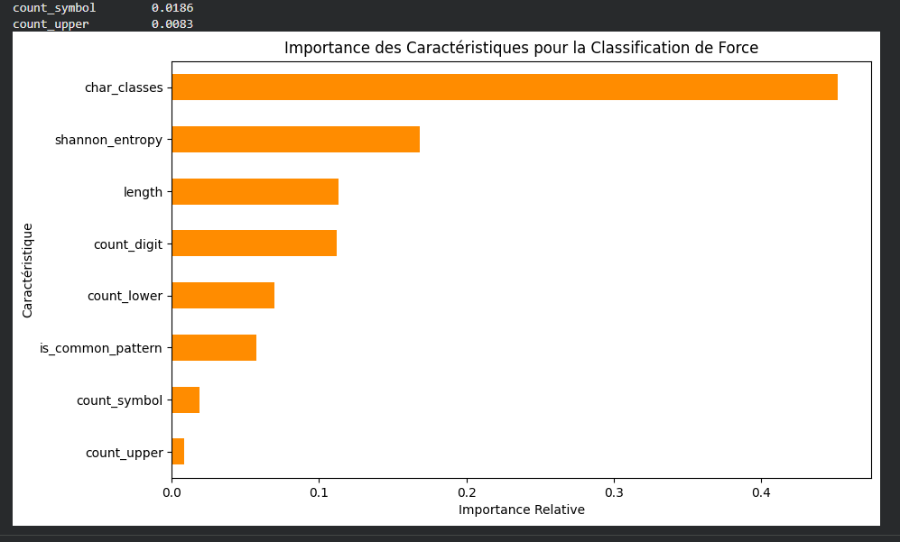
6. Feature Importance: The Predictors
  Our analysis reveals the true components of password strength.
Contribution of Features to the Model's Decision
Character Classes (45.3%)
Shannon Entropy (16.8%)
  Crucial Finding: The model confirmed that complexity and unpredictability are far more critical than simple total length.
9

Slide 10
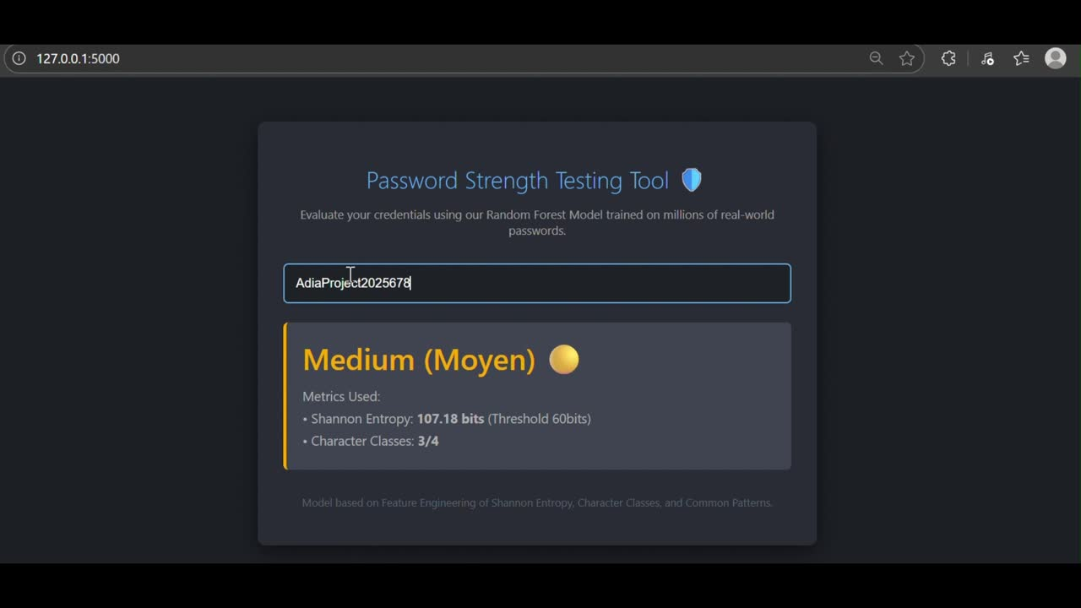
7. Live Classification demonstration
  The Flask application uses the Random Forest model to instantly classify new input based on its features (Entropy, Classes, Patterns) to WEAK (0), MEDIUM (1) or STRONG (2).
10

Slide 11
8. Actionable Recommendations for a SOC
  Based on our model's findings, we propose three data-driven policy change:
1. Mandate Character Complexity
  Policy: Enforce a strict requirement for 4 Character Classes (lowercase, uppercase, digits, and symbols).
  Data-Backed Justification: Our model identified char_classes as the most powerful predictor (45.3% importance). This is the single most effective way to guarantee high entropy.
2. Enforce an Entropy Baseline
  Policy: Algorithmically reject any new password with a calculated Shannon Entropy below 60 bits.
  Data-Backed Justification: This moves security from a simple "length" rule to a scientific "time-to-crack" metric. It guarantees resistance to brute-force attacks.
3. Block Known-Weak Patterns
  Policy: Implement a real-time filter (like our is_common_pattern regex) to reject common sequences, repetitions, and dictionary words.
  Data-Backed Justification: This protects against human
11

Slide 12
9. Conclusion / Project Summary
  Our contribution: From traditional rules to data-driven security.
i. Project Key Contributions:
  Quantified Findings:We scientifically proved the critical failure of low char_classes usage in the RockYou dataset.
  Accurate Model: Random Forest achieved a perfect F1-Score (1.00) in classifying password strength.
  Solution: We delivered a functional Flask Web Demonstration of the classification model.
ii. Future Perspectives:
  Integration of the model into an authentication API (production deployment).
  Analysis of advanced attack patterns (e.g., Leetspeak variations) for ongoing maintenance.
12

Slide 13


Thank You!
Your feedback and questions are welcome.

